Slide 1
ICC Features
Supporting unlimited projects per ICC
  Advanced technical support
Friendly registration utility
5 password-levels
exceptional workspace (features and look)
  Fix - Automatic site graphic display
  User - SDACA-like, create your own flexible displays
Server/Client installation
  Operates over any Windows-supported network
Features

Slide 2
ICC Features
Advanced interrogation concept
Multi lingual
  Switch language on the fly
Creating and printing database reports of all tables
Upload Field Unit data (wizard) from the field into the ICC program
Define your own image per I/O to be displayed in the graphic section
Sensors program
Line display and definitions
I/O table for each Field Unit
Features

Slide 3
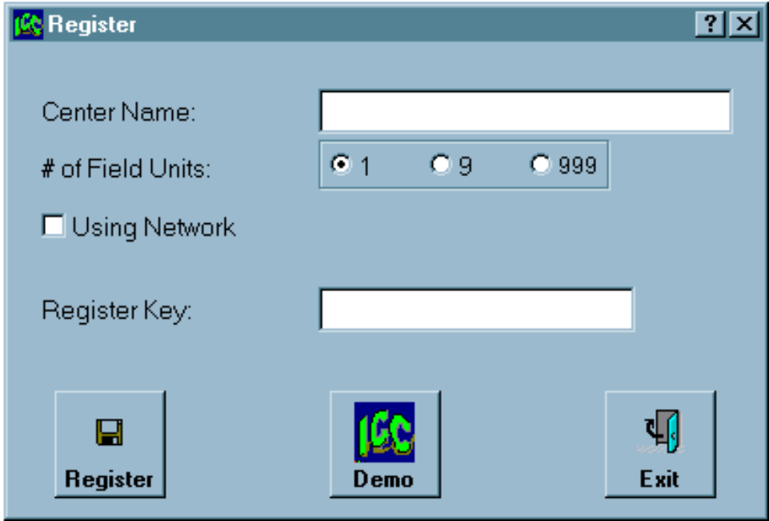
ICC - Registration
you are here
after typing the
correct key
Registration Key
Demo Only.
All features may be used
without communication
One station, network, demo

Slide 4
ICC - Order Of Work
File/Projects
  Open/Create Project
System
  System definitions
System
  Areas Definitions
System
  Field Units Definitions
System
  I/O Definitions
Follow this order to simplify data entry process

Slide 5
ICC - Order Of Work
System
  Main Lines definitions
    General, Irrigation, Fert Parameters
    Filter flushing batteries and then filter parameters
System
  View all I/Os in the I/O table
System
  Define crop types and attach Main-Line to crop
Follow this order to simplify data entry process

Slide 6
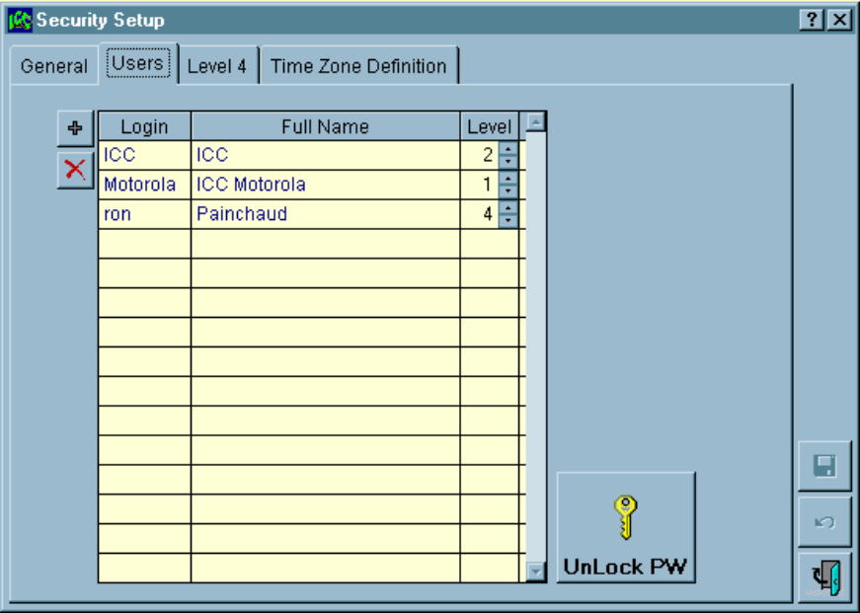
ICC - Password Levels
5 Levels of password
  Level 1 - Motorola (changes in ICC SW)
  Level 2 - Technician (all changes but Motorola’s)
  Level 3 - Manager (all but expert Com. Parameters)
  Level 4 - Area Manager (no setup changes, may be limited to certain areas)
  Level 5 - Viewer only (still must login)
Manager always knows who logged in and when

Slide 7
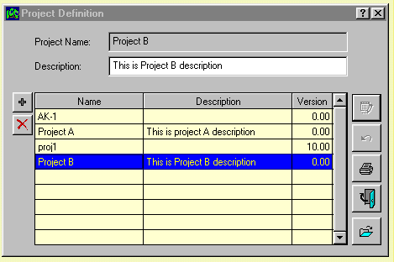
ICC - Project Definition
Unlimited Number of Projects
List of
Projects
Open a
Project
Work with projects to backup, service and support

Slide 8
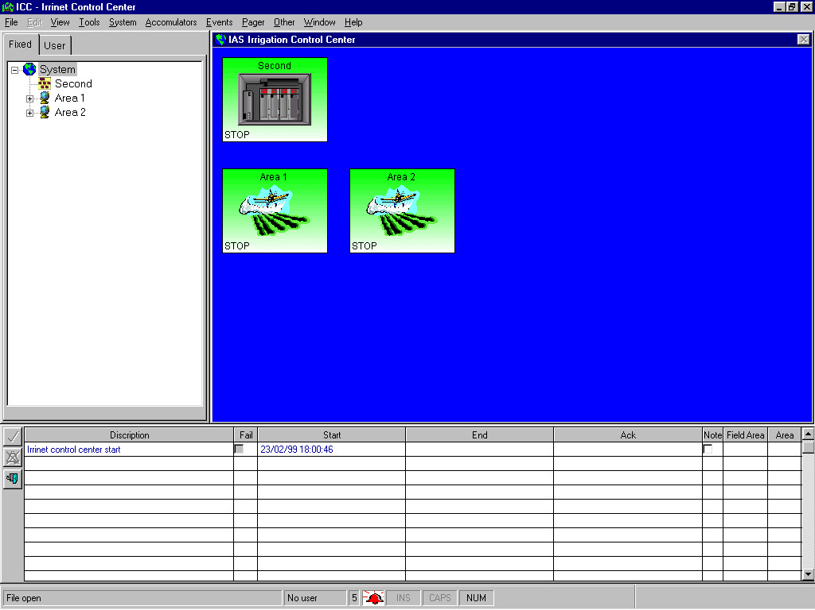
ICC - IRRInet Control Center Workspace
Explorer
Tree
Display
Area
Logging events
Windows workspace

Slide 9
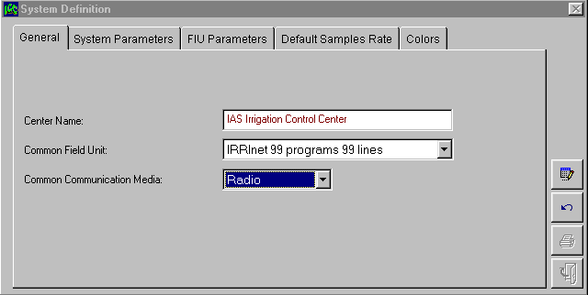
ICC - System Definition
Save Changes
Undo Changes
Print a Report
Exit Table
Defining system and communication parameters

Slide 10
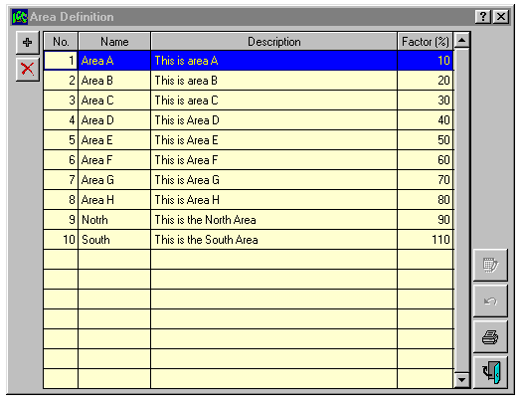
ICC - Area Definition
Add to the list
Delete from list
Each area has its own image. Create an area report

Slide 11
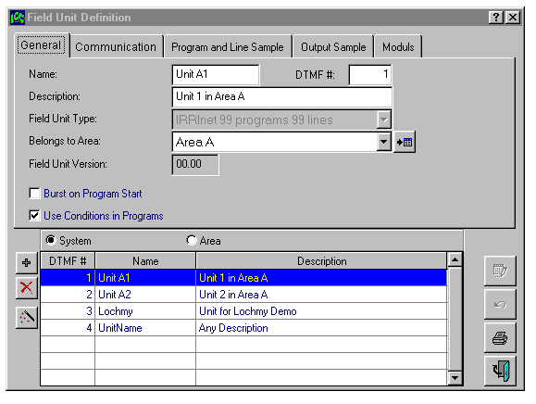
ICC - Field Unit (FU) Definition
FU DTMF #
Wizard
upload FU data
List of FU
Wizard utility to retrieve Field Unit Information and data to the center

Slide 12
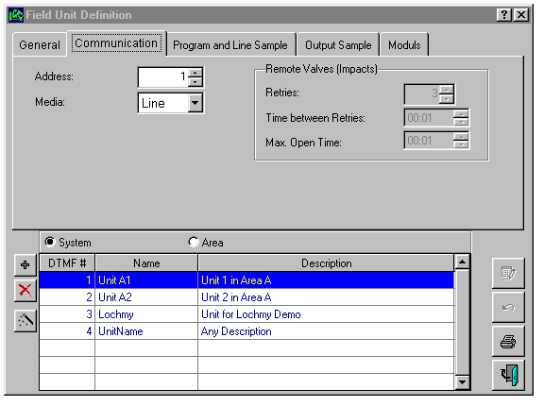
ICC - Field Unit Definition
Impact
parameters
FU or area sorting
Create and print
a report with all
FU data

Slide 13
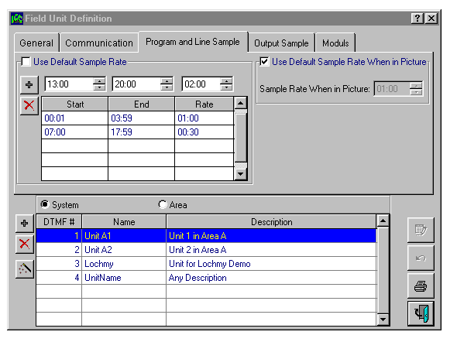
ICC - Field Unit Definition
Irrigation programs, line status and I/Os interrogation
Default interrogation
or
create your scheduler
per FU
Use different
interrogation rate
when object is displayed
on screen
View all FUs
or
FU per area
How to define interrogations ?

Slide 14
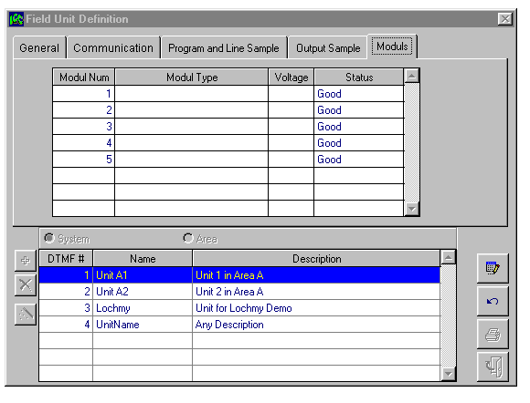
ICC - Field Unit Definition
Define
or
upload
modules
structure
Define or Upload Field Unit’s Modules Structure

Slide 15
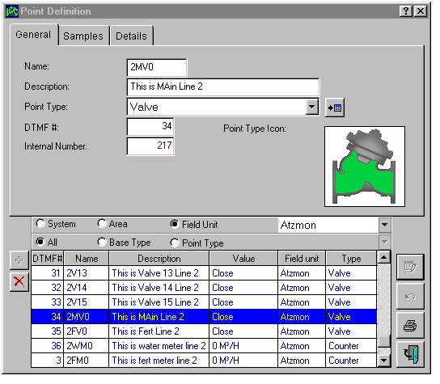
ICC - I/O Definitions
Select image
and other parameters
from a predefined list
or
create your own
I/O types
Select your
I/O list view
User-defined
image representing
I/O in the
graphic
section
List of all
the I/Os
in the project
Create your own image for any I/O to be displayed in the graphic section

Slide 16
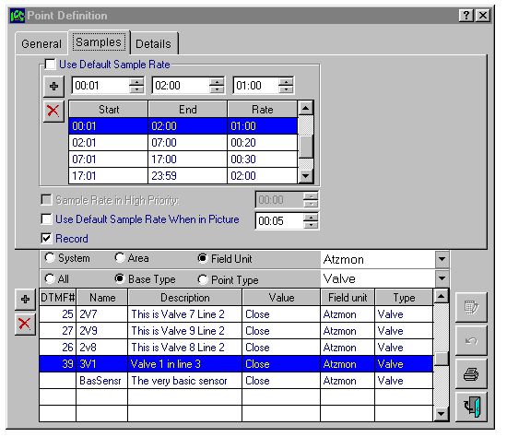
ICC - I/O Definitions
Use default
sample rate
or
create specific
schedule
per I/O
Select “Record”
for history
file
Click on the tab
to sort
View all I/Os parameters and current status

Slide 17
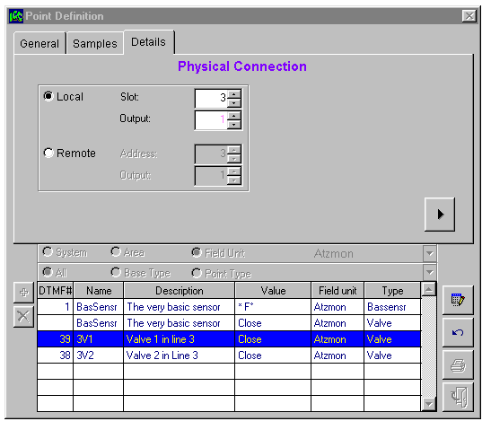
ICC - I/O Definitions
Different colors
to avoid mistakes
in physical
connections
Connect to
local I/O
or
remote
(Scorpio/Impact)
Click for more
parameters
ICC prompts to avoid mistakes in physical connections

Slide 18
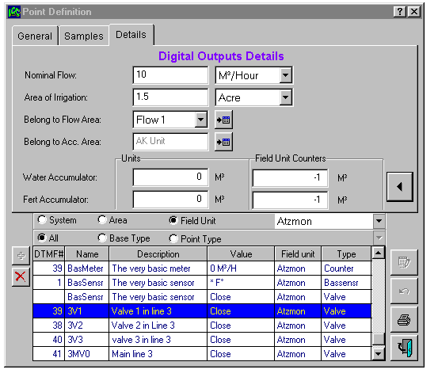


ICC - I/O Definitions
Additional data
per
I/O type
Data of
digital output
(valve)
Actual
and
calculated
accumulation
Fill-in all relevant date to benefit from all ICC features

Slide 19
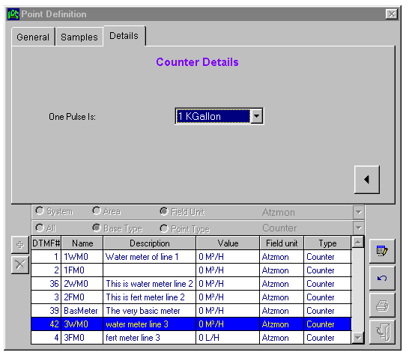
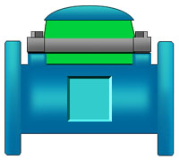
ICC - I/O Definitions
Data for
counter
(Water & Fert Meter)
Fill-in all relevant date to benefit from all ICC features

Slide 20
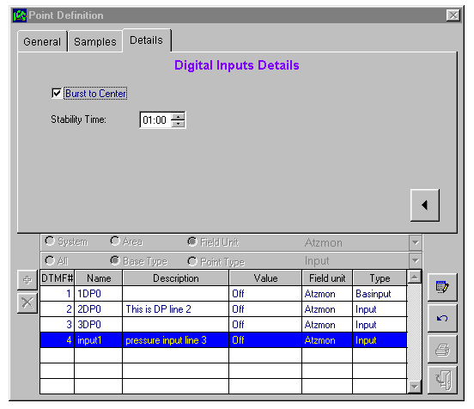

ICC - I/O Definitions
Data for
digital input
(alarm, pressure etc.)
Fill-in all relevant date to benefit from all ICC features

Slide 21
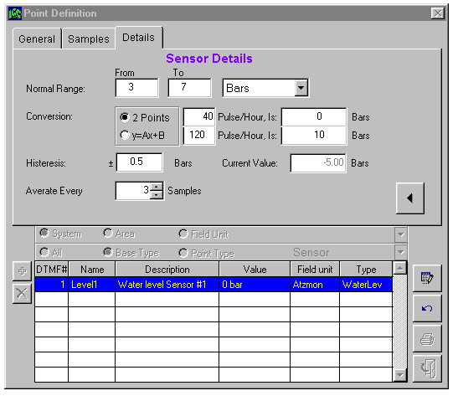
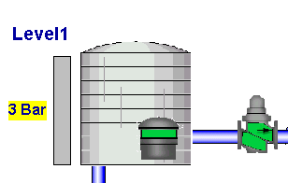
ICC - I/O Definitions
Sensor
preferences
Normal
3-7 Bar
Below normal
0-2 Bar
Over normal
8-10 Bar
Actual ICC
view
Fill-in all relevant date to benefit from all ICC features

Slide 22
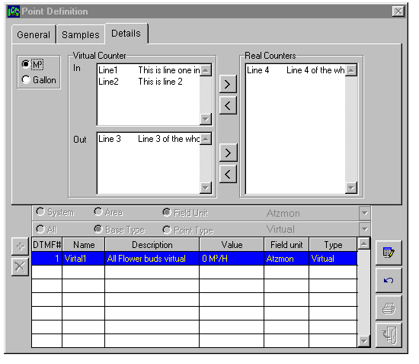
ICC - I/O Definitions
In meters
Meters
in stock
Out meters
Create virtual water meter, then create virtual line

Slide 23
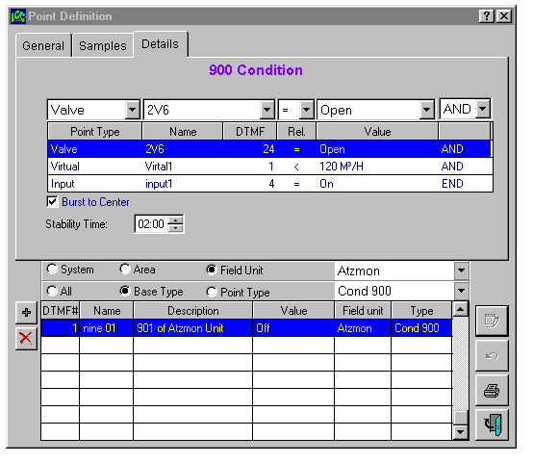
ICC - I/O Definitions
“900” Condition
definitions
“500”, “600”, and “900” Conditions are also I/Os you need to define

Slide 24
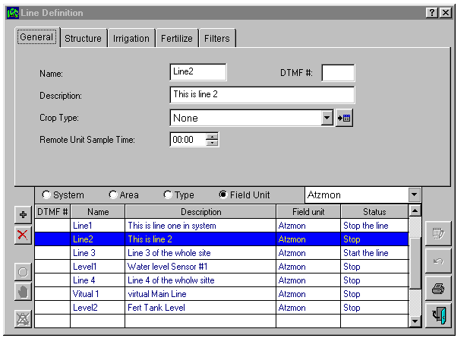
ICC - Main Lines Definitions
General Main Line
data
Select your
view of the
Main Line
Go to
table
Per line:
Start
Stop
Clear alarm
Display system, area, type or one Field Unit Main Lines

Slide 25
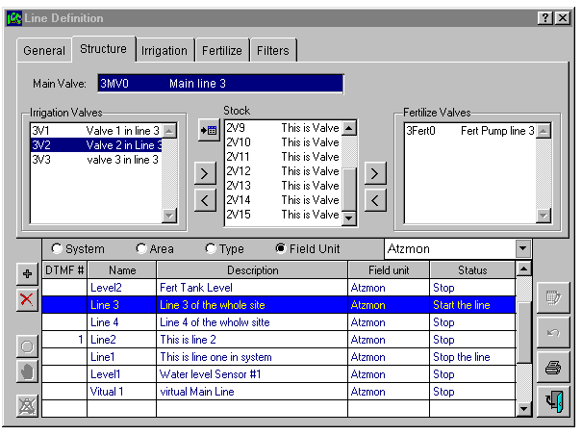
ICC - Main Lines Definitions
Drag and Drop stations from stock to be: irrigation zones, main valve or fert pump

Slide 26
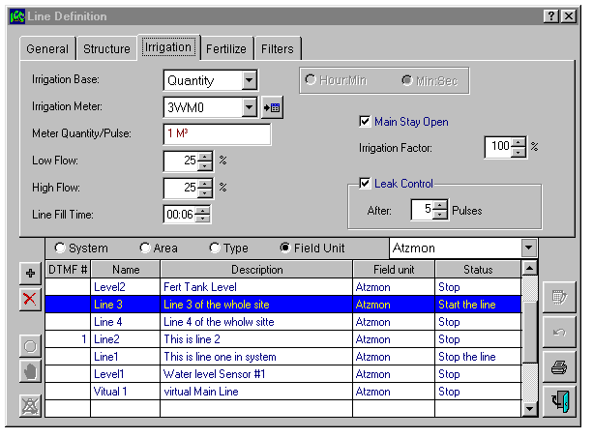
ICC - Main Lines Definitions
Water / Run-Time parameters

Slide 27
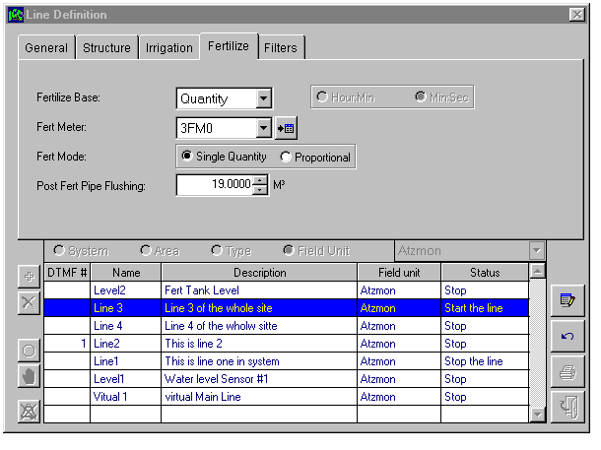
ICC - Main Lines Definitions
Fert parameters

Slide 28
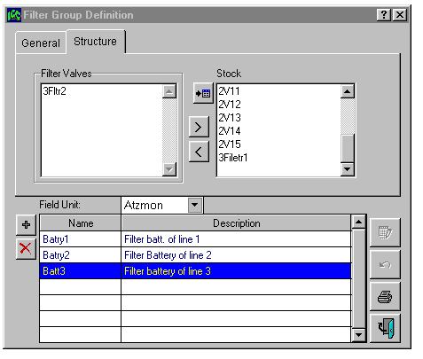
ICC - Main Lines Definitions
Select filters
out of the
free valves
or
stations belong to
that Main Line
Define filter batteries before defining filter parameters

Slide 29
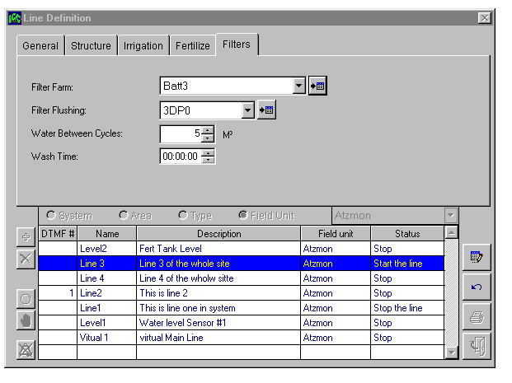
ICC - Main Lines Definitions
Filter parameters

Slide 30
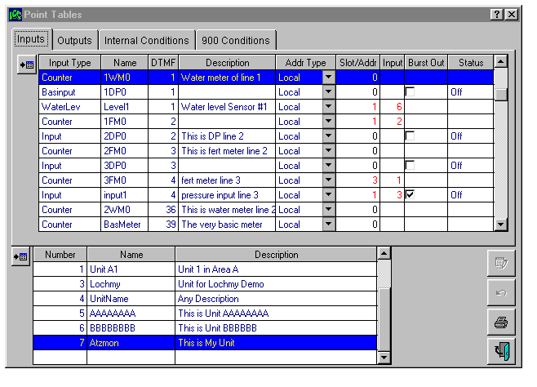
ICC - Main Lines Definitions
For each Field Unit - list of all defined I/Os. Make changes in this table

Slide 31
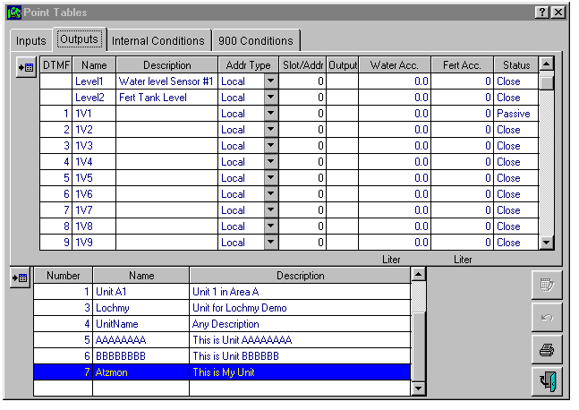
ICC - Main Lines Definitions
For each Field Unit - view water and fert accumulations

Slide 32
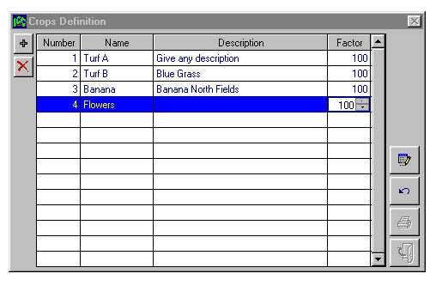
ICC - Crop Types Definitions
Change run-time
factor
per crop type
Each Main line may be attached to Crop Type

Slide 33
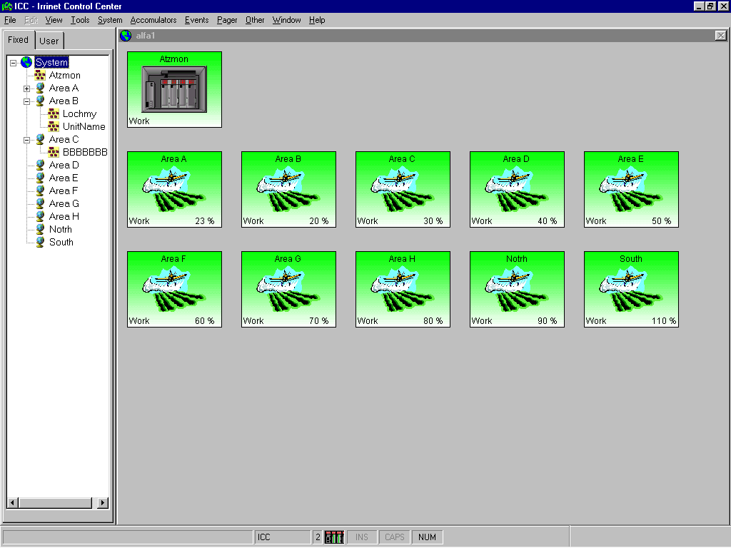
ICC - Fix Screens
Your selection
on the tree
is displayed here
Explorer-like
tree
Click on Area to view Field Units
Click on Field Unit to view I/Os
Created automatically according to your definitions

Slide 34
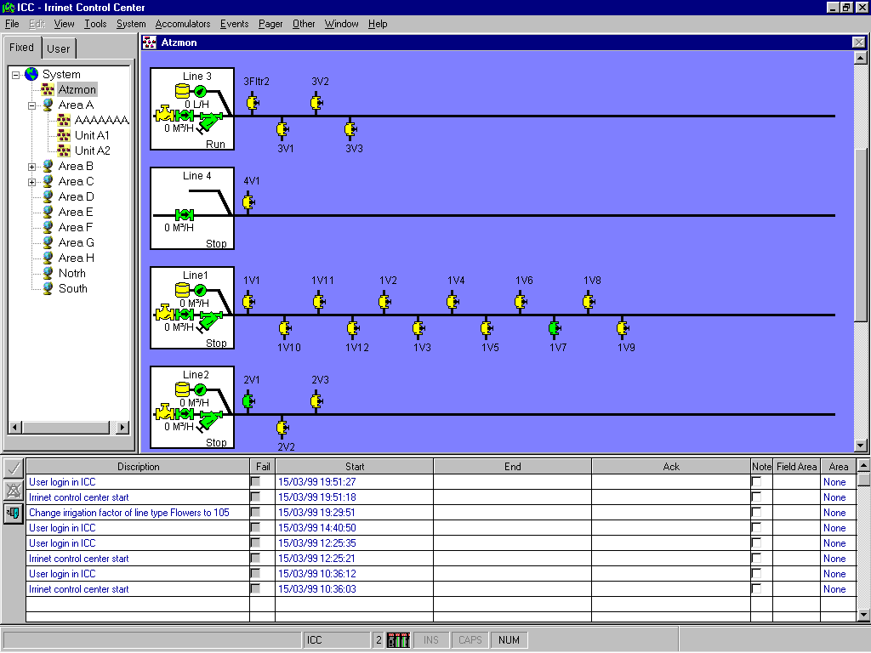
ICC - Fix Screens
Created automatically
Use the right mouse button to view more info and go to other tables

Slide 35
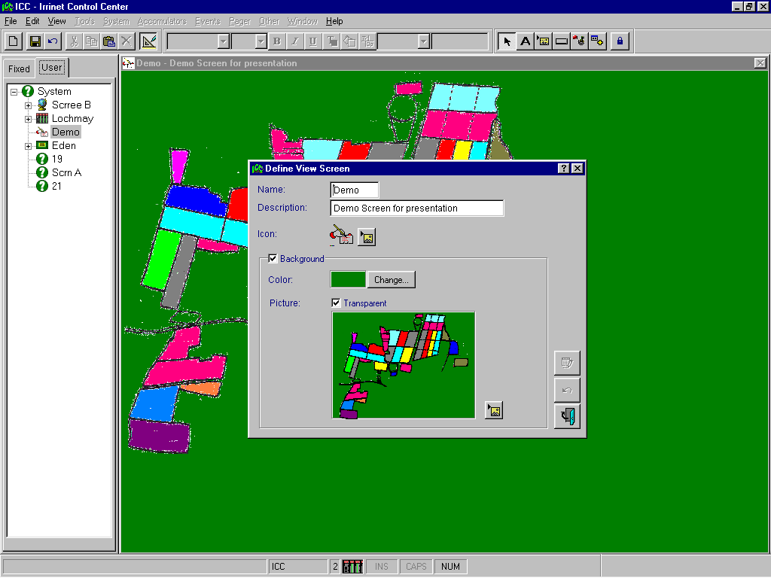
ICC - User’s Screen - Creating New
Edit button
Enter name
Description
Icon
Use the
right mouse button
to place and create
a new screen
Background
color
Background
picture
Enter the EDIT mode and create a new screen

Slide 36
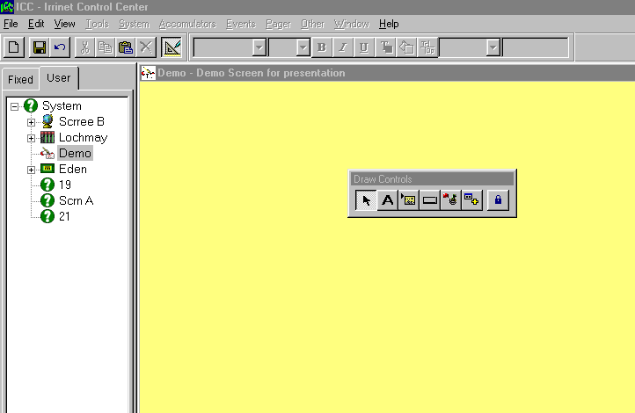
ICC - User’s Screen - Adding Elements
Pictures are like “clipart”
Create Buttons
to cruse
between screens
Pointing
Lock last
Selection
Element:
Output
Input
Sensor….
Object:
Area
Field Unit
Main Line...
Add Object
Text Labels
Add Element
Add Picture
Add Button
After defining:
Screen name, Description (option), Icon (option), Background Color (option), Background Picture (option)
You may add elements and objects to that screen
You may place the toolbar, anywhere on the workspace

Slide 37
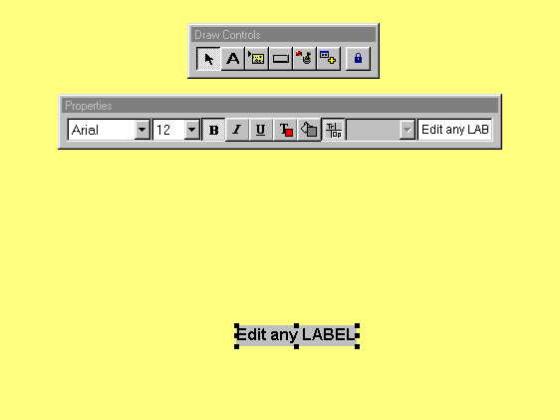
ICC - User’s Screen - Adding Elements/labels
Select label.
place the mouse
on the display area.
Click the mouse.
Change label
properties
Edit label text
and hit “Enter”
Font Color
Opaque
Transparent
Select Font
Font Background
Select an item and using the mouse place it anywhere on the display area

Slide 38
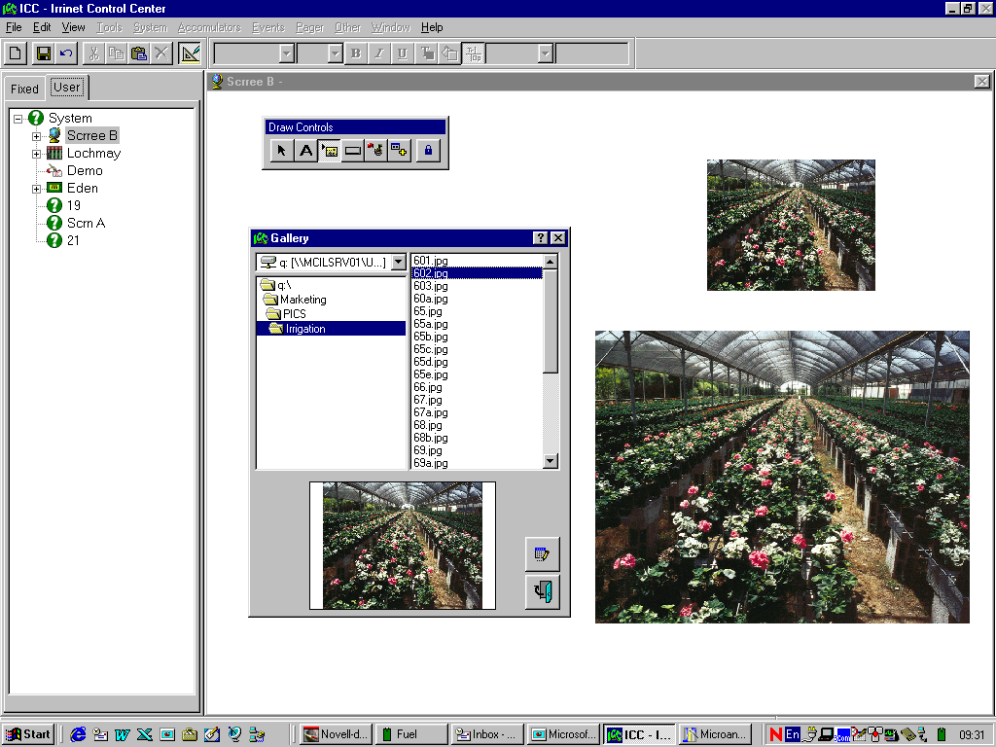
ICC - User’s Screen - Adding Elements/Pictures
1. Select Picture
After selecting
picture,
place the mouse on the display area
and click.
4. You may
change
properties:
Opaque/
Transparent
of the white
picture’s
background
color
2. Explore
your PC
to find
the required
picture
3. Drag the picture
to the required
position and resize it
3. Save your
selection,
and exit
Select an item and with the mouse place it anywhere on the display area

Slide 39
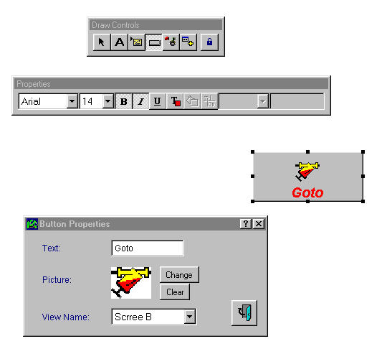
ICC - User’s Screen - Adding Elements/Button
1. Select Button
After selecting Button,
place the mouse on the display area and click,
to create a Button.
4. You may change
the button’s text
properties.
2. Select Button,
click the right mouse
button and select
“EDIT”, to
modify Button
properties.
3. Modify properties:
Text on Button
Icon On Button
Screen to move when click
on
Select an item and using the mouse place it anywhere on the display area

Slide 40
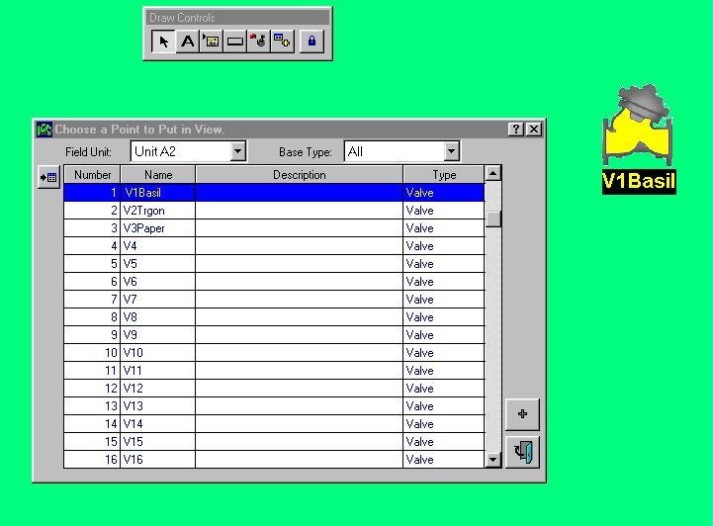
ICC - User’s Screen - Adding Elements/I/O’s
1. Select Element
After selecting Add Element, place the mouse on the
display area and click..
The table of all I/O’s will appear.
2. Select Field Unit
2. Select I/O type
You may change the
I/O’s text properties.
5. The selected I/O will appear
on the display area.
3. Select specific I/O
4. Click [+] and exit
Select an item and using the mouse, place it anywhere on the display area

Slide 41
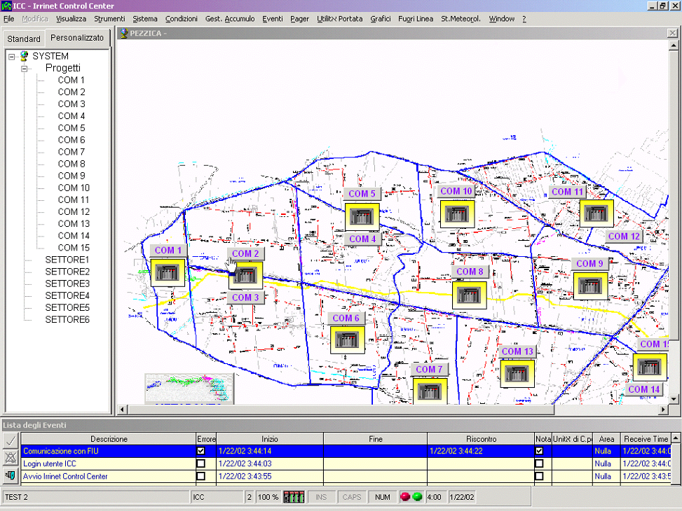

Slide 42
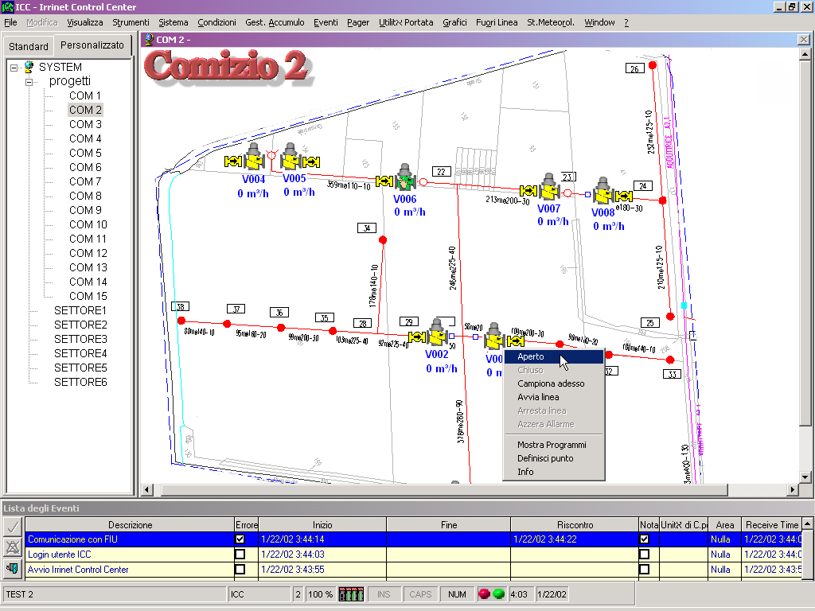

Slide 43
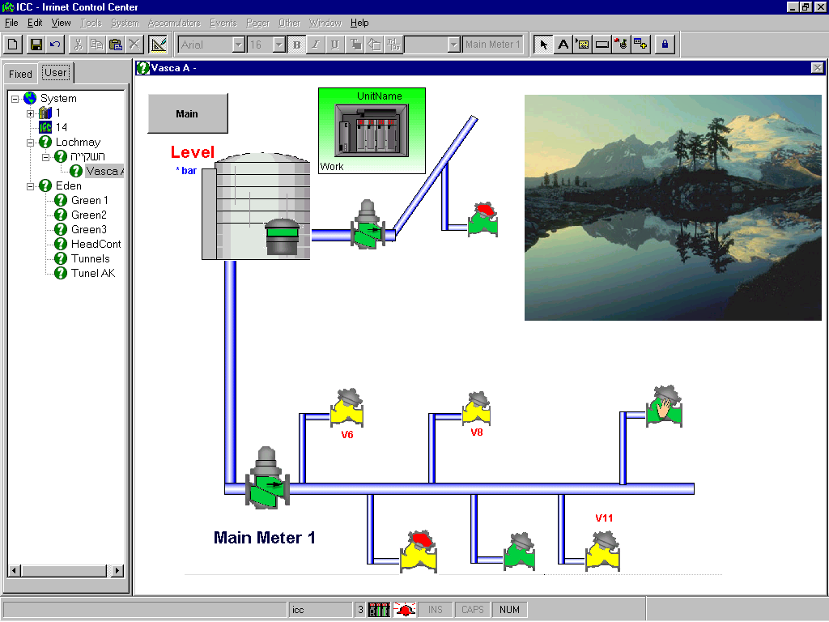

Slide 44
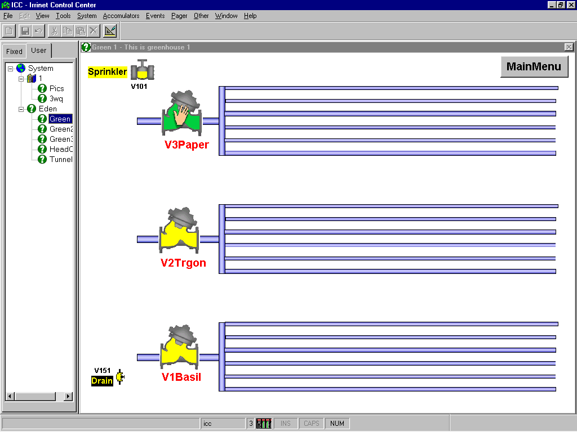

Slide 45
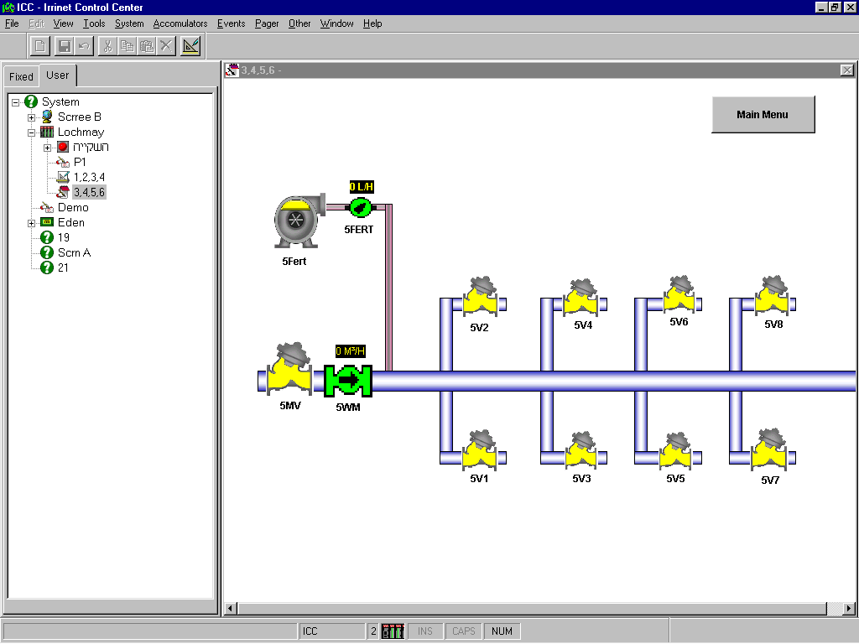

Slide 46
